Slide 1
COLLEGE CONNECT
Submitted in the partial fulfillment for the award of the degree of
BACHELOR OF ENGINEERING
IN
CLOUD COMPUTING
Submitted by:
ADITYA ANKIT ISHITA GUPTA
20BCS4140 20BC4144 20BCS4048
Under the Supervision of:
ANKIT GARG
Department of AIT-CSE
DISCOVER . LEARN . EMPOWER

Slide 2
Outline
Introduction to Project
Problem Formulation
Objectives of the work
Methodology used
Results and Outputs
Conclusion
Future Scope
References

Slide 3
Introduction to Project
"College Connect" is poised to redefine the landscape of campus engagement by introducing a dynamic and unified digital platform. Aimed at seamlessly bridging the gap between physical and virtual interactions, this innovative system is designed to empower students, alumni, faculty, and staff through enhanced collaboration, mentorship, knowledge sharing, and efficient resource distribution.
Key Features:
User Profiles and Connectivity
Mentorship Programs
Resource Sharing and Discussions
Event Listings and Notifications
Job and Internship Portal
Alumni Engagement and Contributions

Slide 4
Problem Formulation
Lack of a comprehensive and integrated platform for communication and collaboration
The absence of a centralized space where students, alumni, faculty, and staff can easily connect, share insights, and collaborate hampers the seamless exchange of knowledge, mentorship, and opportunities.
Fragmented information dissemination, limited mentorship
Students face challenges in discovering suitable job and internship opportunities,
Alumni find it difficult to engage meaningfully with the college community.
Opportunities for students to engage in knowledge exchange
Campus engagement often remains confined to physical spaces and times
Resource Redundancy

Slide 5
Objectives
1. Comprehensive Needs Assessment
2. Effective Platform Design
3. Structured Mentorship Framework
4. Enhanced Resource Sharing
5. Efficient Event Management
6. Job and Internship Portal
7. Alumni Engagement Enhancement
8. Promote Collaborative Learning
9. Real-time Interaction
10. User Experience Enhancement

Slide 6
Methodology used
The research methodology for developing the "College Connect" platform involves a structured and iterative approach .The methodology encompasses several key phases:
Requirement Analysis
System Design
Development
Testing and Validation
User Feedback Incorporation
Deployment
Training and Onboarding
Continuous Improvement
Evaluation
Documentation and Reporting

Slide 7
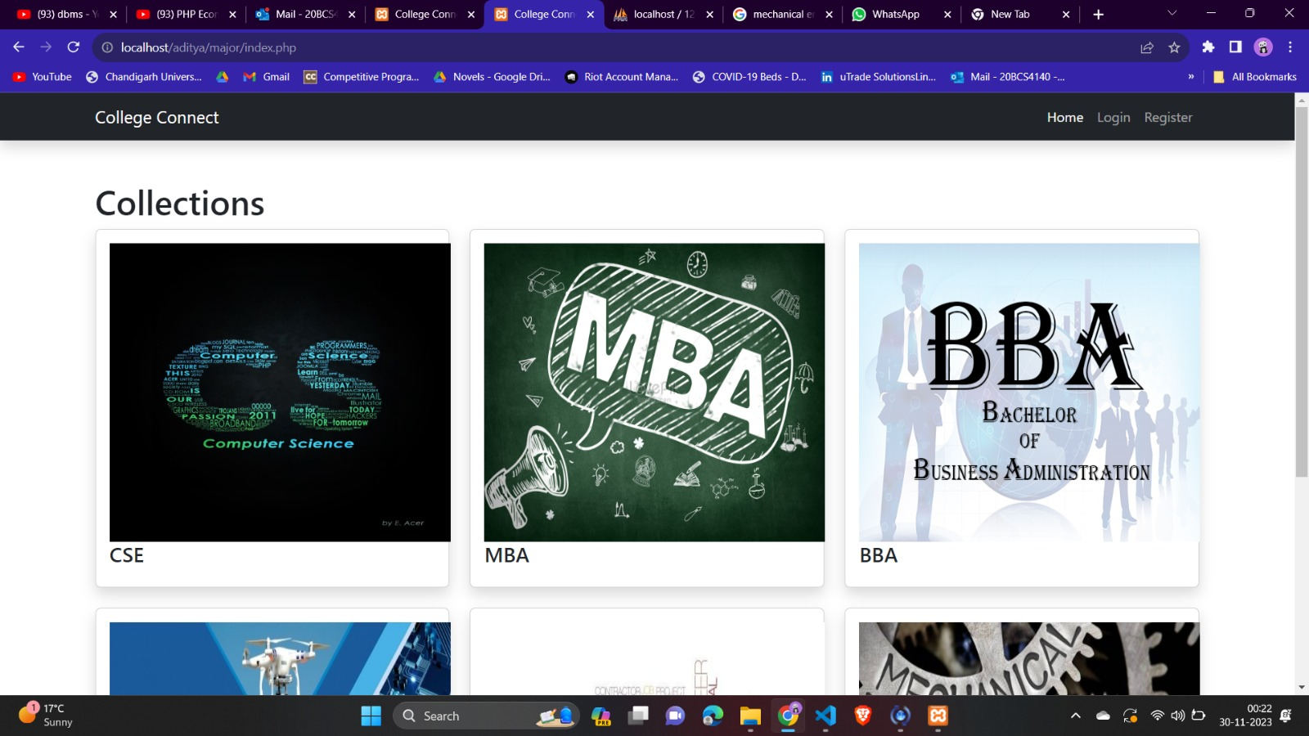
Results and Outputs
CHAPT

Slide 8
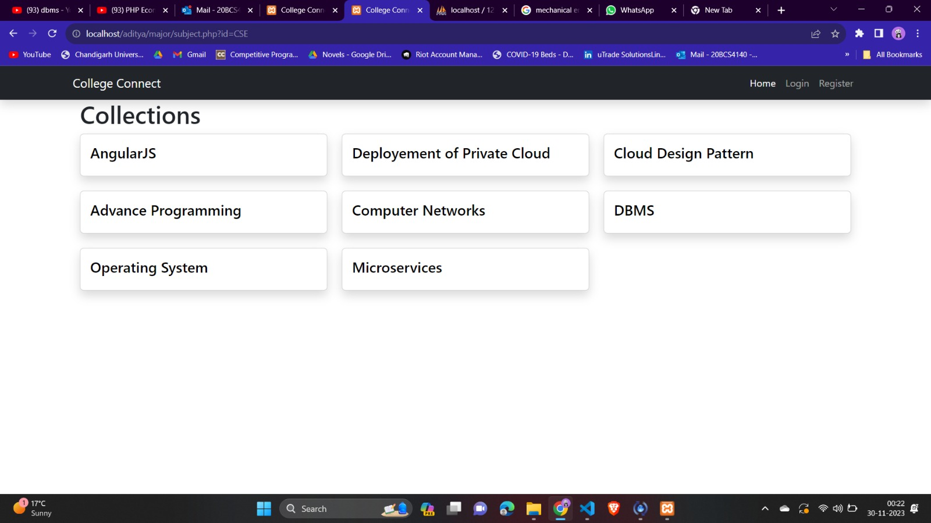
Collection of Subjects inside CSE stream

Slide 9
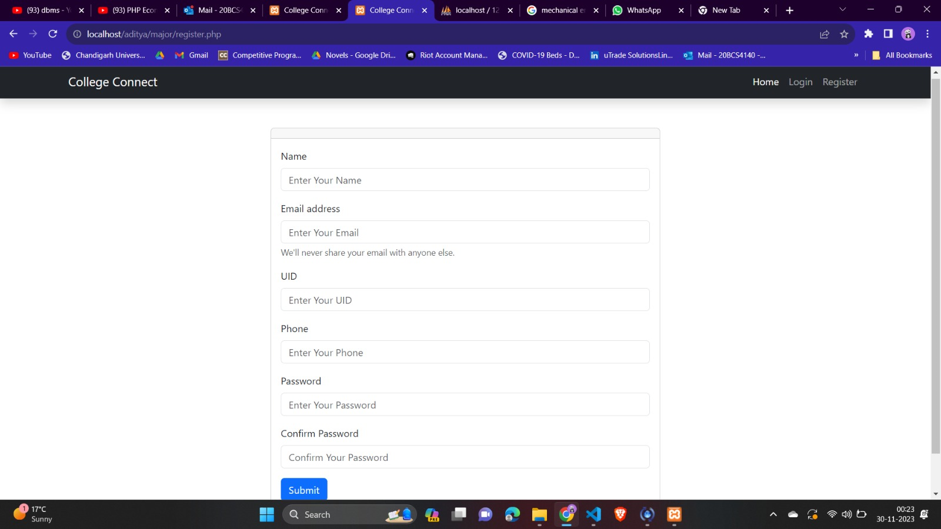
SIGNUP:

Slide 10
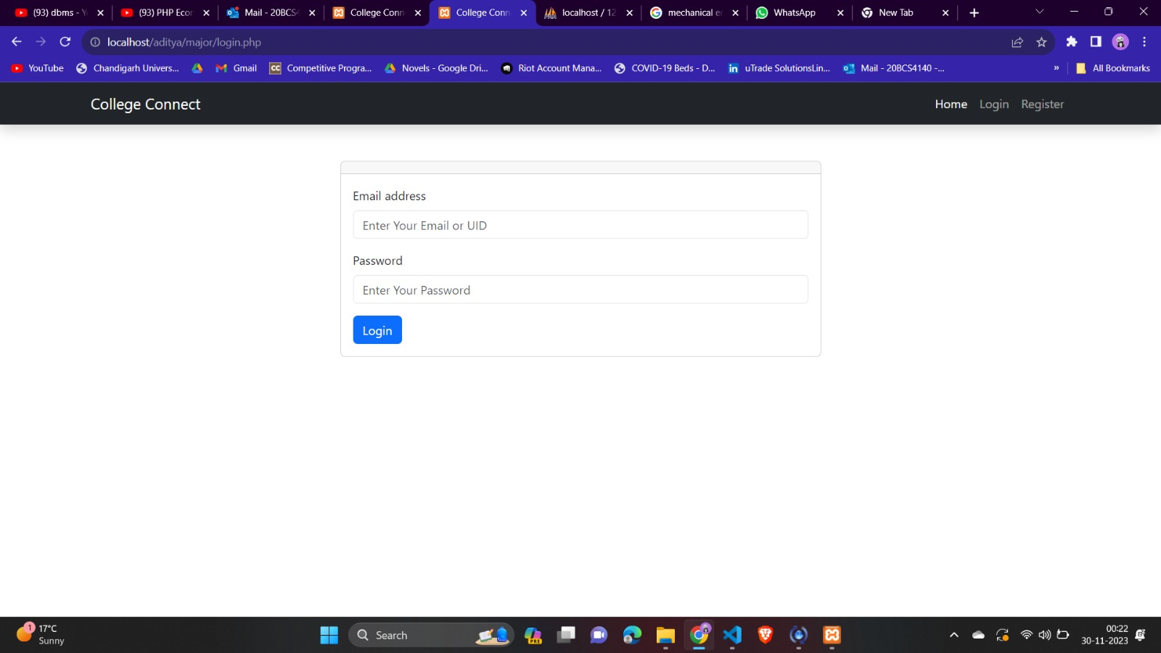
LOGIN

Slide 11
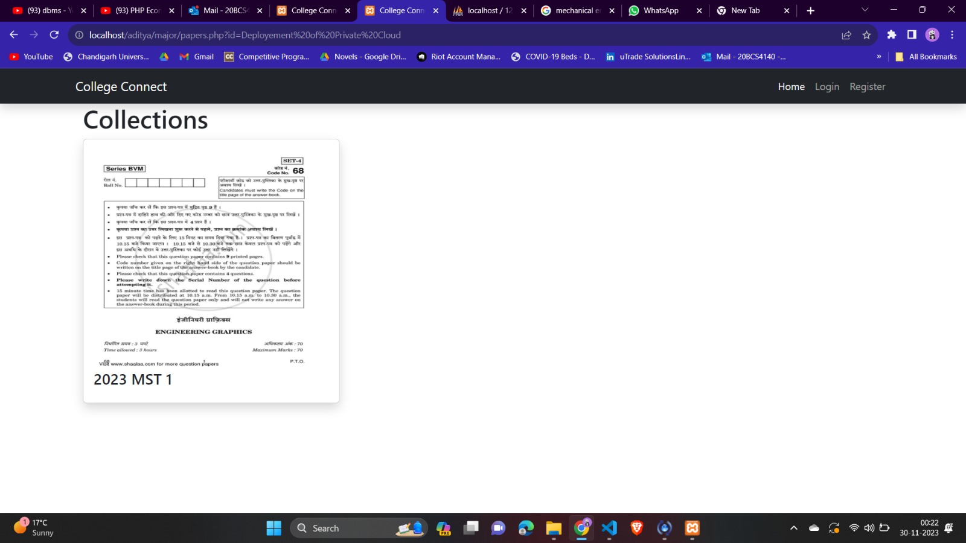
Question papers:

Slide 12
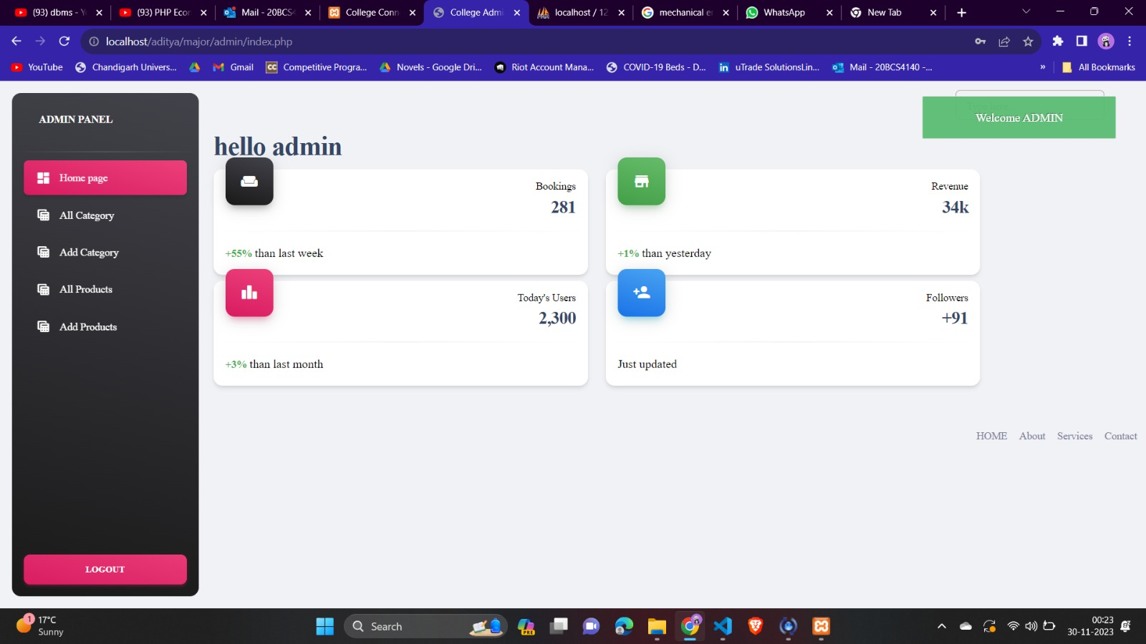
Admin Panel:

Slide 13
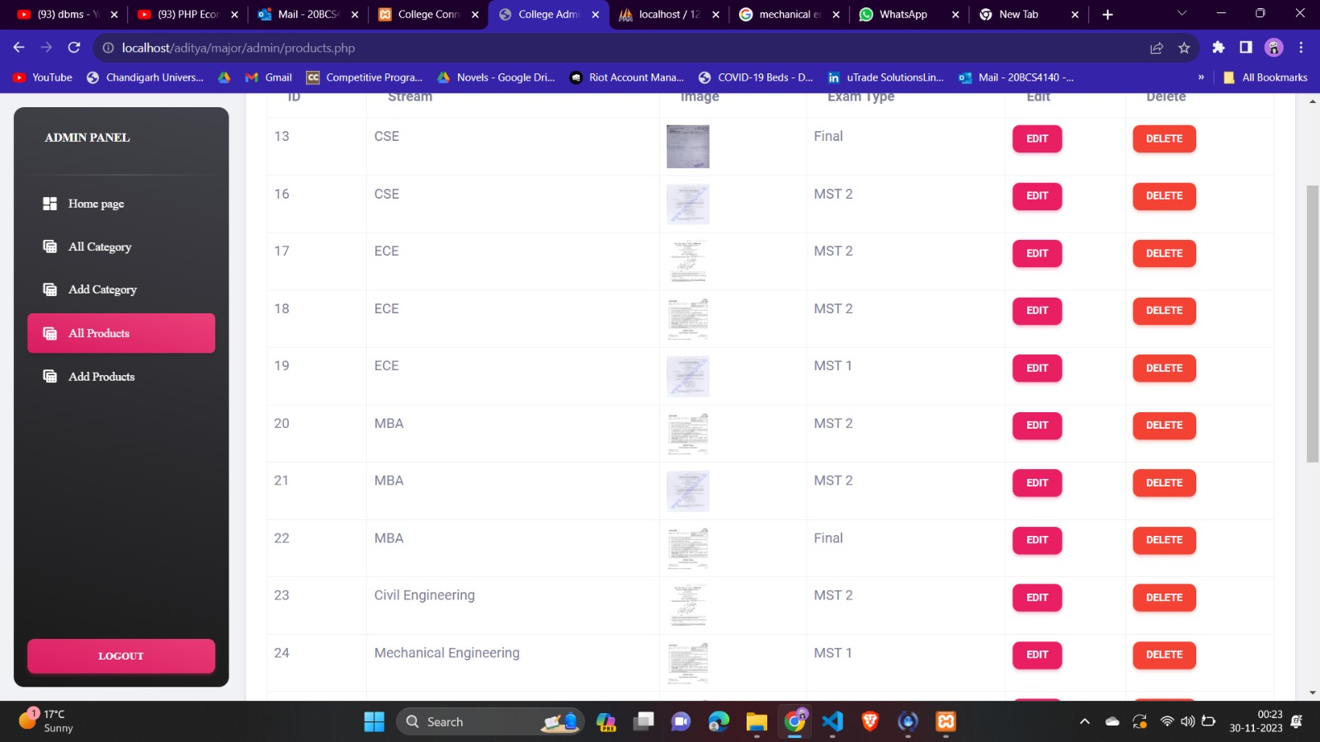
Product:

Slide 14
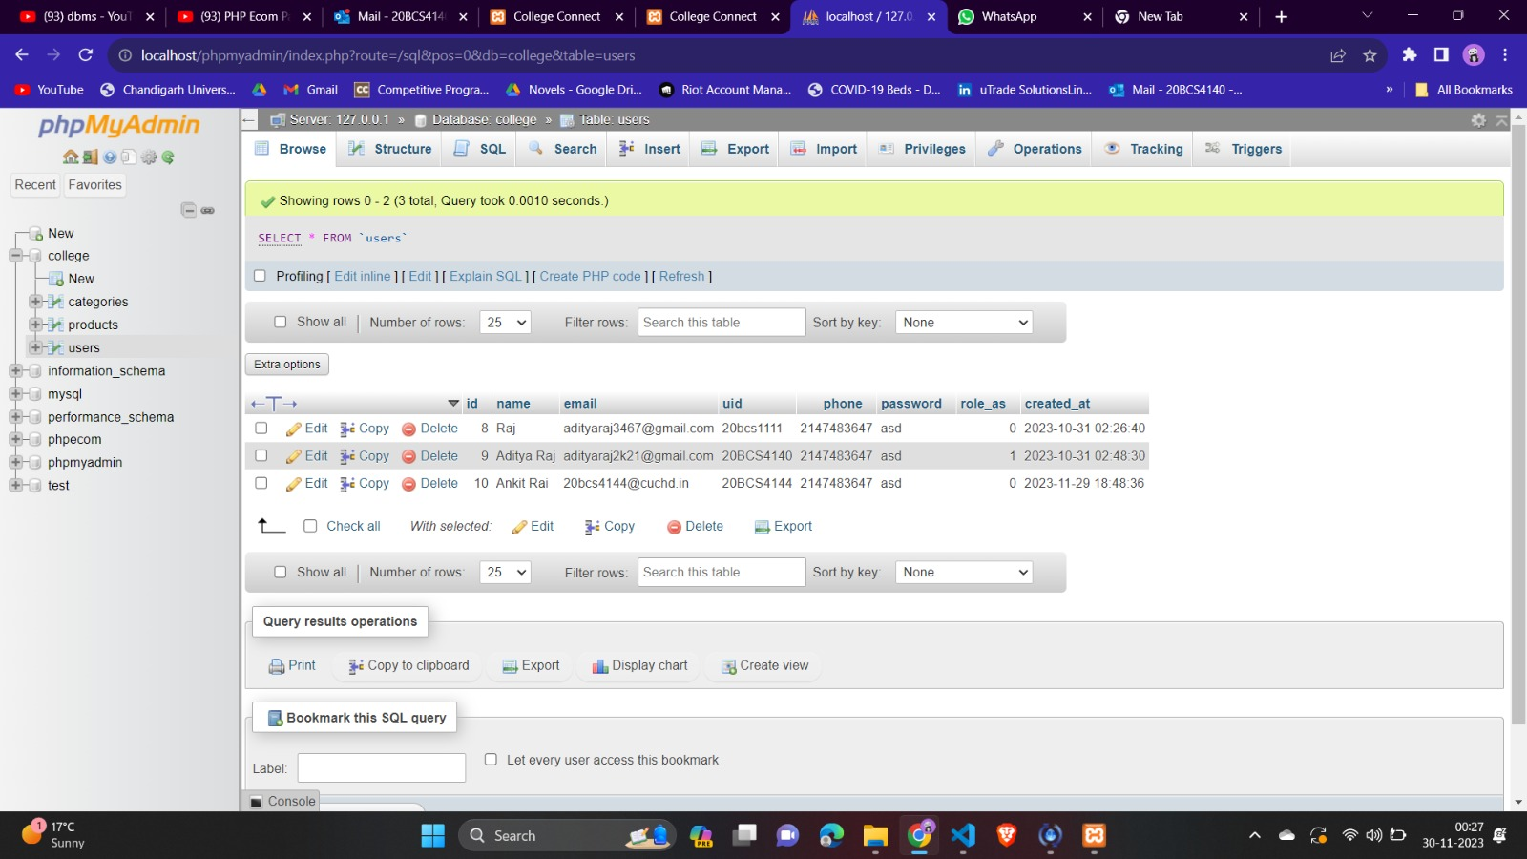
MySQL Database:

Slide 15
Conclusion
Through comprehensive research, thoughtful design, and strategic execution, the platform has addressed the limitations of the existing system and created a vibrant online ecosystem for students, alumni, faculty, and staff. In conclusion, the "College Connect" platform has laid the foundation for a more connected, engaged, and empowered college community. . Alumni engagement has been revitalized, and collaborative learning has thrived within the discussion boards. Its success paves the way for continuous evolution, ensuring that the platform remains a catalyst for enhancing campus engagement and fostering a collaborative learning environment well into the future. The platform's real-time interaction features have fostered a sense of community, enriching user experiences.

Slide 16
Future Scope
Here are potential areas of enhancement for the system:
Integration with Artificial Intelligence: AI can offer personalized recommendations, mentorship and resources.
Use of Big Data Analytics: Implementing big data analytics within College Connect can provide valuable insights into user behaviours, preferences, and trends
Mobile Applications: This facilitates quick access to event updates, mentorship connections, and other features, enhancing overall user experience.
Integration with Smart Campus Infrastructure: College Connect can integrate with smart campus infrastructure, utilizing technologies such as IoT devices and campus-wide sensors.
Use of Blockchain Technology: Blockchain technology can enhance the security and transparency of College Connect.
Integration with Social Media Platform

Slide 17
References
1. Smith, J. K., & Johnson, L. M. (2018). Digital Platforms and Campus Engagement: A Review of Current Trends and Practices in Higher Education. Journal of Educational Technology, 20(2), 45-58.
2. Brown, A. R., & Williams, E. S. (2020). Enhancing Alumni Engagement through Digital Platforms: A Case Study of Three Universities. International Journal of Educational Technology in Higher Education, 17(1), 1-15.
3. Johnson, M. P., & Davis, R. S. (2019). Building an Effective Mentorship Program: Insights from Online Educational Platforms. Journal of Student Affairs, 35(2), 87-101.
4. Adams, L. G., & Martinez, C. L. (2017). Online Resource Sharing and Collaborative Learning: Impact on Student Performance. Journal of Interactive Learning Research, 28(3), 337-355.
5. Chen, H., & Wang, Y. (2018). The Impact of Digital Platforms on Alumni Engagement and Contributions. International Journal of Nonprofit and Voluntary Sector Marketing, 23(4), e1617

Slide 18
References
6. Clark, J. A., & Smith, R. B. (2019). Digital Engagement in Higher Education: Challenges and Opportunities. Journal of Higher Education Management, 34(2), 87-101.
7. Educational Technology Association. (2021). Emerging Trends in Educational Technology: Insights for Higher Education. (https://www.edtechassociation.org/reports/emerging-trends-higher-education)
8. Nielsen, L. B., & Jones, S. M. (2019). Effective Design Principles for Digital Learning Platforms. International Journal of Education and Technology, 22(3), 145-162.
9. University of XYZ Alumni Association. (2022). Alumni Engagement Report: A Look at the Impact of Digital Platforms. (https://www.xyzalumniassociation.edu/reports/alumni-engagement-report)
10. Smith, P. W., & Thompson, A. M. (2020). Digital Communities and Campus Engagement: Insights from a Comparative Study. Journal of Higher Education Technology, 25(1), 12-27.

